Slide 1
AI-Enabled Social Cyber Maneuver Detection and Creation
Matthew Hicks
Thesis Proposal
Spring 2024
Committee
Kathleen M. Carley, Chair
Patrick Park
Mohamed Farag
David M. Beskow, USMA

Slide 2
Thesis Work Completion Key
Disclaimers:
The research for this thesis was supported in part by the Office of Naval Research (ONR) under grant N00014182106, the United States Army under grant W911NF20D0002, and the center for Informed Democracy and Social-cybersecurity (IDeaS). The views and conclusions are those of the authors and should not be interpreted as representing the official policies, either expressed or implied, of the ONR, the United States Army, or the US Government.
The appearance of U.S. Department of Defense (DoD) visual information does not imply or constitute DoD endorsement.
Work done by others and background to the thesis research
Work already completed as a part of this thesis
Work currently in-progress
Work not yet started

Slide 3
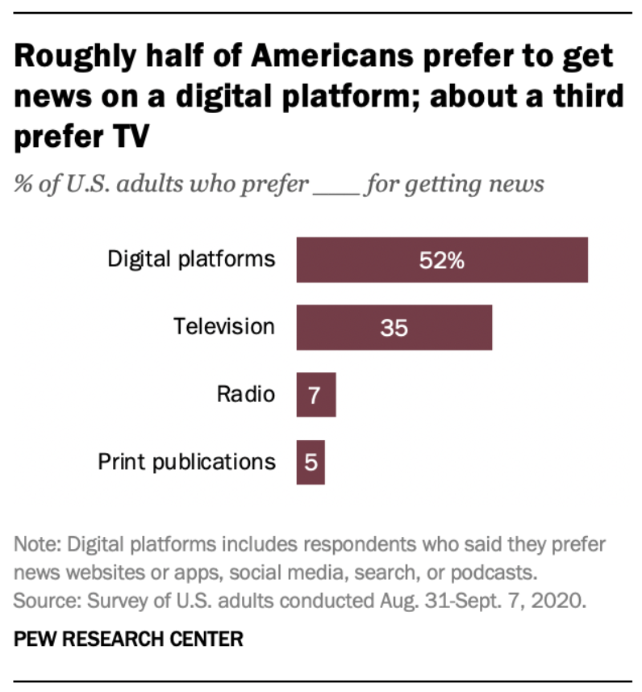
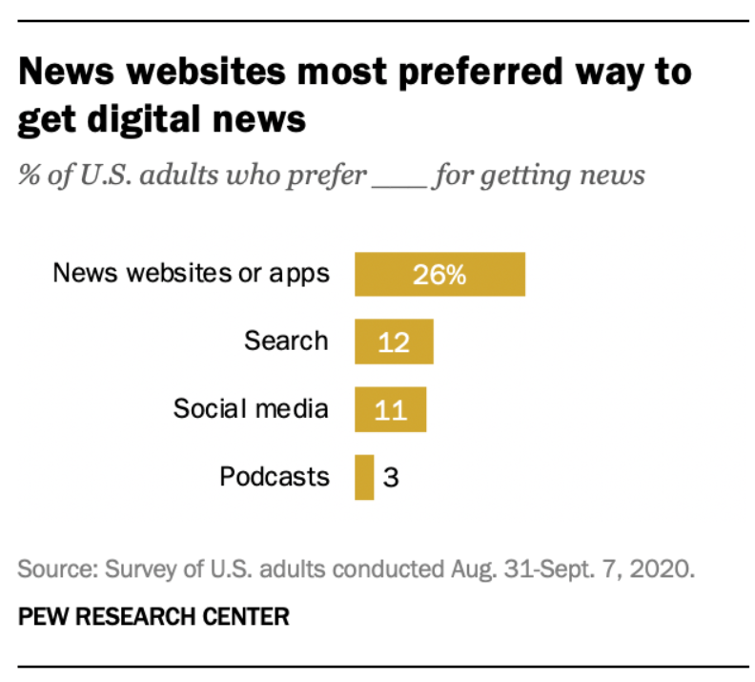
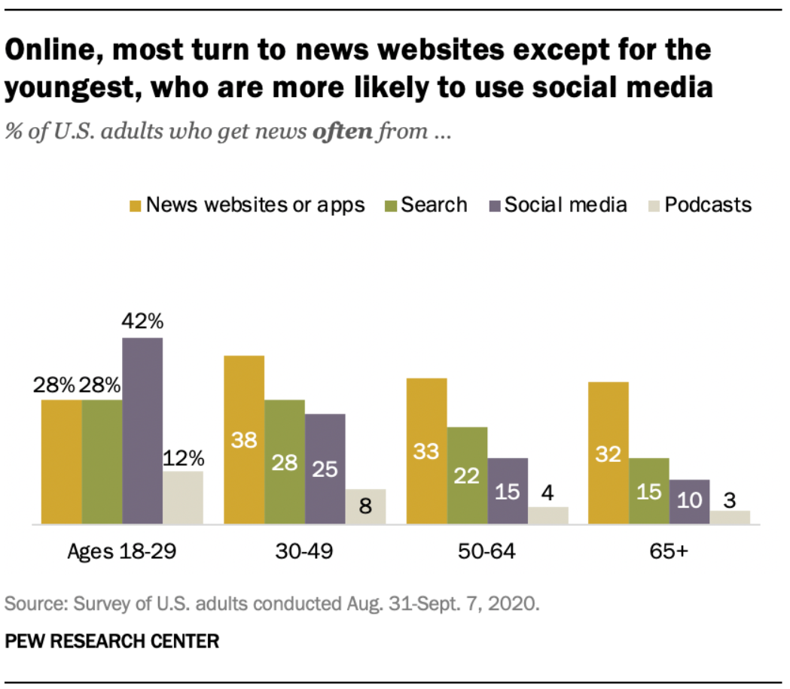
Social-Cyber Security
Shearer, Elisa. Pew Research Center. “More than eight-in-ten U.S. adults say they get news from a smartphone, computer or tablet ‘often’ or ‘sometimes.’” 12 January 2021. https://pewrsr.ch/2MZqns7
Notes:
More…

Slide 4
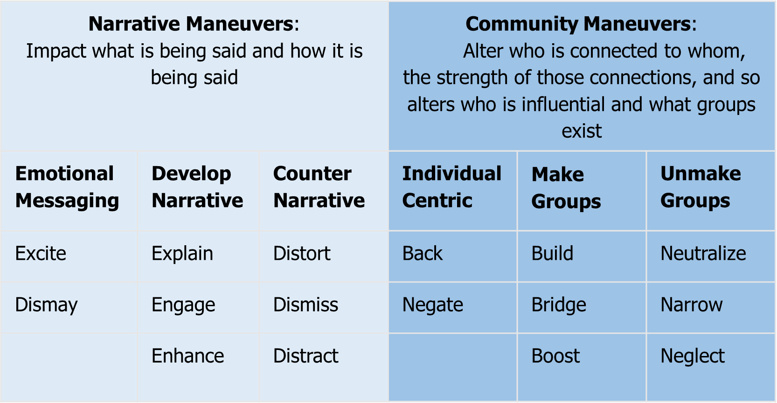
Social-Cyber Security
BEND provides a framework for describing information space maneuvers
BEND allows us to frame:
(Source) Who
(Payload) Maneuver
(Target) On Whom
(Effect) Impact
Notes:
More…

Slide 5
Major questions and motivation
BEND Improvements
Study 1: BEND effects-based detection | Dynamic network analysis, online interaction, social media
Study 2: BEND Simulation | Agent-based modeling and simulation, maneuver and counter-maneuver
BEND Training
Application 1: BEND Scenario Generation | Network analysis, social media, LLMs
Application 2: BEND Social Media Generation | LLMs, modeling and simulation, online interactions, social media
BEND Doctrine
US DoD Doctrine-BEND Synthesis | Doctrine, network analysis, network visualization

Slide 6
Major questions and motivation
Q1: How can we detect the presence of BEND maneuvers through their effects? Can we match these maneuvers to narrative campaigns?
Q2: How can we develop exercise training scenarios for the BEND framework?
Can we extract a training scenario from real data without resorting to hand-crafting messages?
How can we leverage AI/LLMs to enhance training scenarios and generate multi-modal BEND?
Q3: How does the BEND framework fit into current military doctrine and how can it enhance current information environment analysis?

Slide 7
Purpose
The purpose of this thesis is to:
Move BEND beyond a theoretical discussion framework and into an operationally relevant construct for evaluating social-cybersecurity
Detect maneuver effects and connect them with broader BEND campaigns
Identify BEND maneuver and counter-maneuver
Leverage AI to develop synthetic training scenarios that closely mirror real word data with minimal human intervention
Nest BEND within current US military doctrine
Notes:
The purpose of this thesis is to move BEND beyond a theoretical discussion framework and into an operationally relevant construct for evaluating social-cybersecurity; this is is accomplished by nesting BEND within current US military doctrine, identifying countermeasures to BEND maneuvers, connecting detected maneuver effects with broader BEND campaigns, and ultimately leveraging AI to develop synthetic training scenarios that closely mirror real word data with minimal human intervention.

Slide 8
BEND Framework Improvements

Slide 9
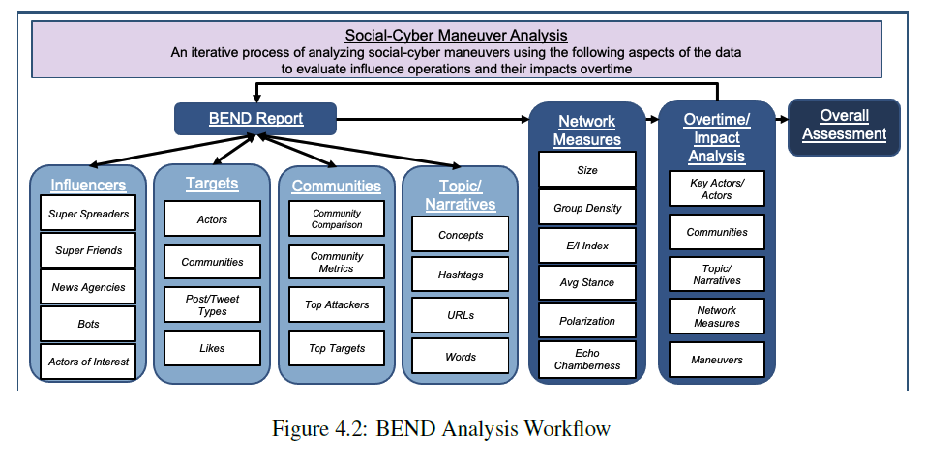
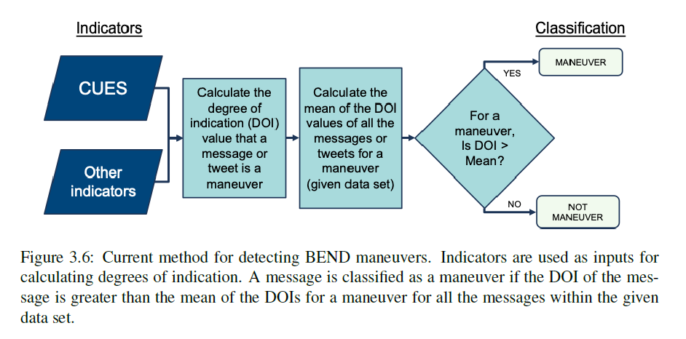
Prior Work
ORA and Netmapper combine to provide a BEND report that automatically detects BEND maneuvers using CUEs and some network metrics
Blane (CMU-S3D-23-102) laid out a more comprehensive framework for analysis and suggested refinements that explored a more complex method for weighting CUEs

Slide 10

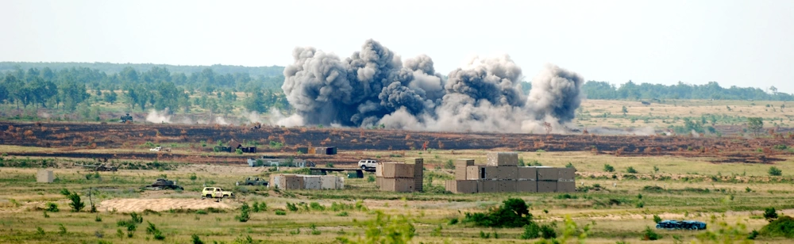
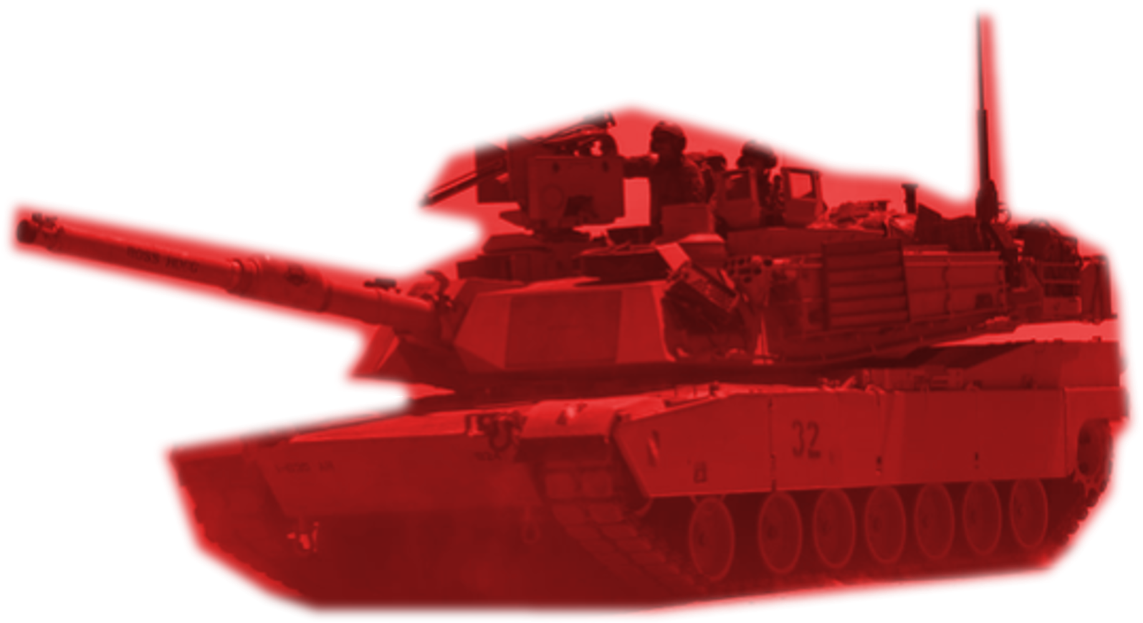
Effects-based Approach
Platform
Source: RedditUser09
Message: People who like dogs are the worst.
Munition/
Payload
Effect: DISMAY (Possibly Multiple)
Effect
Target: People who like dogs (Possibly Multiple)
Target
Prior work takes the Source and Message and attempts to extrapolate an intended Effect to determine BEND maneuvers.
This proposal reverses the process – instead, by identifying Effects experienced by a target to determine the BEND maneuver used. Neither a specific Message or Source is identified.
Requires three additional measures – message level, impact, and target identification.

Slide 11
Effects-based Approach (B)
Name | Definition | Detect
Back | Discussion or actions that increase the actual, or the appearance of, an actor’s importance or effectiveness relative to a community or topic | Centrality in interaction network, importance to group/ changes positively over the time more than the baseline corpus
Build | Discussion or actions that create a group, or the appearance of a group, where there was none before | New group – agent interactions / changes positively over the time more than the baseline corpus
Bridge | Discussion or actions that build a connection between two or more groups or create the appearance of such a connection | Centrality, betweenness of the edge nodes of two groups / changes positively over the time more than the baseline corpus
Boost | Discussion or actions that increase the size of a group and/or the connections among group members, or the appearance of such | Size of group, graph density / changes positively over the time more than the baseline corpus
Notes:
Picture
Over time
More than one effect
How to do Ensembler of more than one effect
Time period of effects bounded by Day? Month

Slide 12
Effects-based Approach (E)
Name | Definition | Detect
Excite | Discussion or actions related to a community or topic that cause the reader to experience a positive emotion such as joy, happiness, liking, or excitement | Target packet emotional valence will be higher in happiness and surprise / changes positively over the time more than the baseline corpus
Explain | Discussion or actions that clarify a topic to the targeted community or actor often by providing details on, or elaborations on, the topic | Topic specialization – additional jargon and net shift towards same stance / changes over the time more than the baseline corpus
Engage | Discussion or actions that increase the relevance of the topic to the reader often by providing anecdotes or enabling direct participation and so suggesting that the reader can impact the topic or will be impacted by it | Topics proportional representation / changes positively over the time more than the baseline corpus
Enhance | Discussion or actions that provide material that expands the scope of the topic for the targeted community or actor often by making the topic the master topic to which other topics are linked | Increased linkage and centrality, betweenness / changes positively over the time more than the baseline corpus

Slide 13
Effects-based Approach (N)
Name | Definition | Detect
Negate | Discussion or actions that decrease the actual, or the appearance of, an actor’s importance or effectiveness relative to a community or topic | Centrality of node / changes negatively over the time more than the baseline corpus
Neutralize | Discussion or actions that cause a group to be, or appear to be, no longer of relevance, e.g., because it was dismantled | Group nodes have more in common with other groups than themselves (group disappears)
Narrow | Discussion or actions that lead a group to be, or appear to be, more specialized, and possibly to fission, or appear to fission, into two or more distinct groups | Multiple groups where only one was present before, fewer links on bipartite network from meta-agent group node to topic/stance nodes
Neglect | Discussion or actions that decrease the size of a group and/or the connections among group members, or the appearance of such | Density and/or size / changes negatively over the time above the baseline corpus

Slide 14
Effects-based Approach (D)
Name | Definition | Detect
Dismay | Discussion or actions related to a community or topic that cause the reader to experience a negative emotion such as worry, sadness, disliking, anger, despair, or fear | Target packet emotional valence will be higher in anger, sadness, fear / changes over the time more than the baseline corpus
Distort | Discussion or actions that obscure a topic to the targeted community or actor often by supporting a particular point of view or calling details into question | Topic specialization – additional jargon and net shift towards opposite stance / changes over the time more than the baseline corpus
Dismiss | Discussion or actions that decrease the relevance of the topic to the reader often by providing stories or information that suggest that the reader cannot impact a topic or be impacted by it | Topics proportional representation / changes negatively over the time more than the baseline corpus
Distract | Discussion or actions that redirect the targeted community or actor to a different topic often by bring up unrelated topics, and making the original topic just one of many | Decreased linkage and centrality, betweenness / changes over the time more than the baseline corpus

Slide 15
Study 1: Real World Effects
Using existing datasets eliminates external dependencies
CUE+ BEND detection through ORA will be compared against effects-based BEND detection
Correlations between attempted BEND maneuvers (CUE+) and observed BEND maneuvers (effects-based) allow for some measure of effectiveness and for the assessment of countermeasures

Slide 16
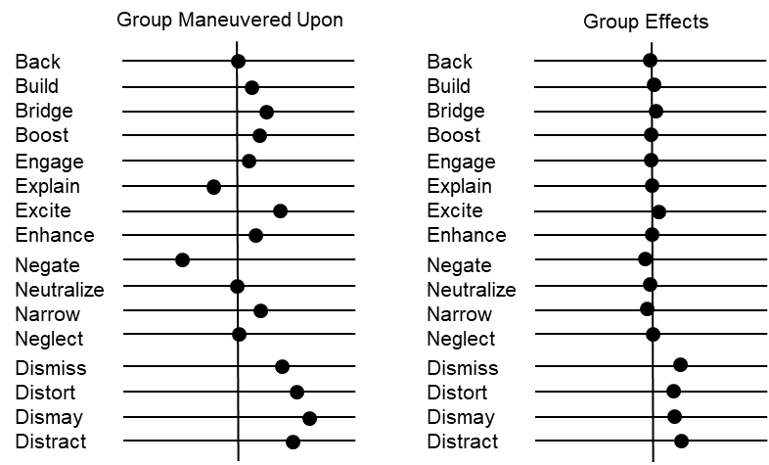
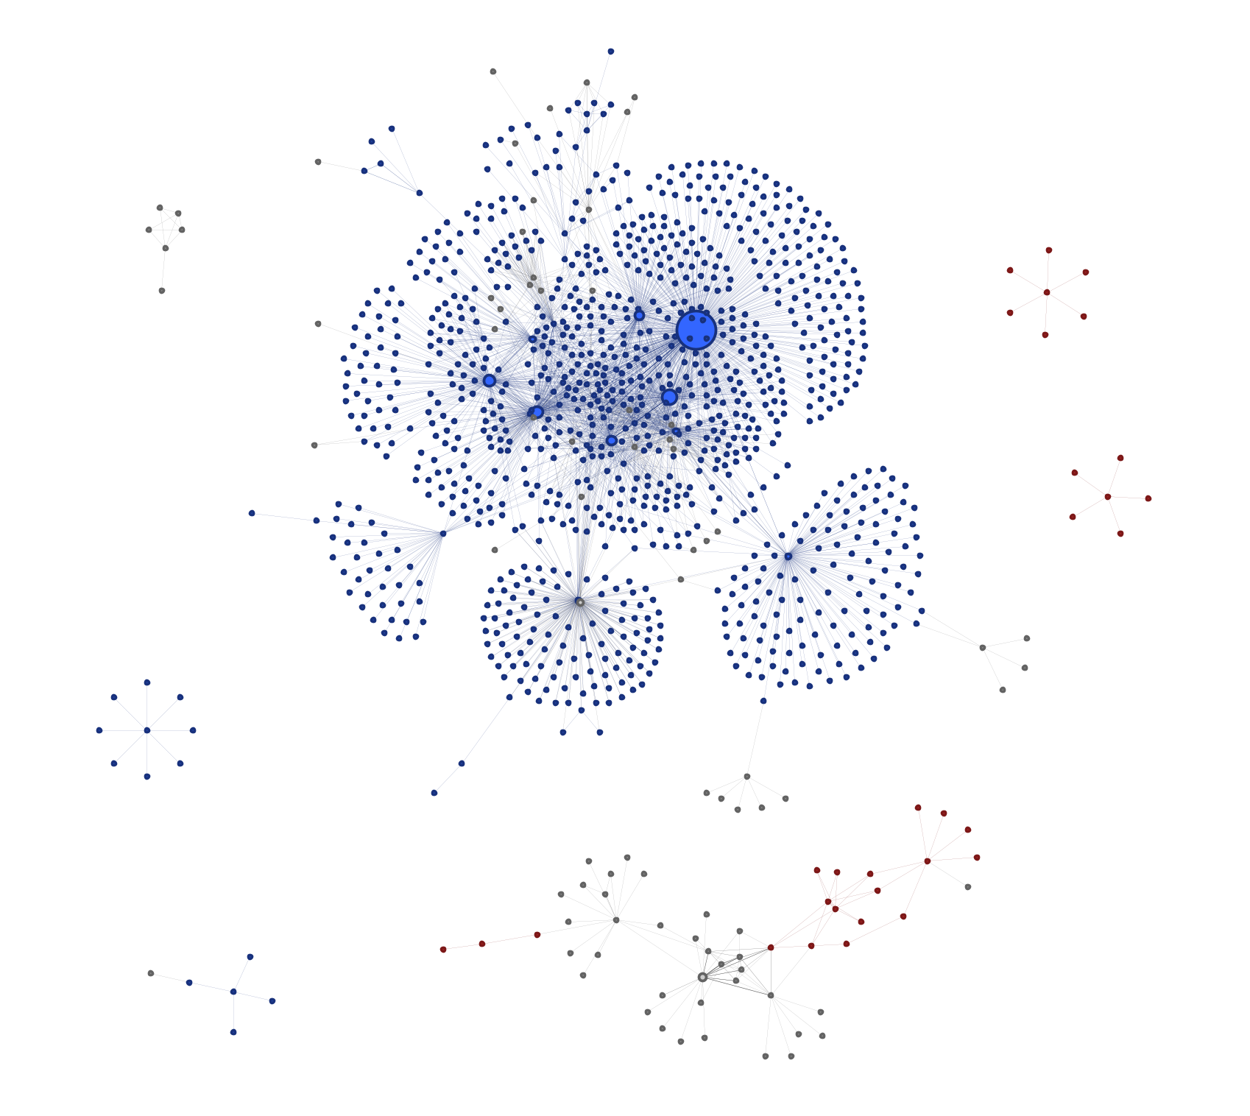
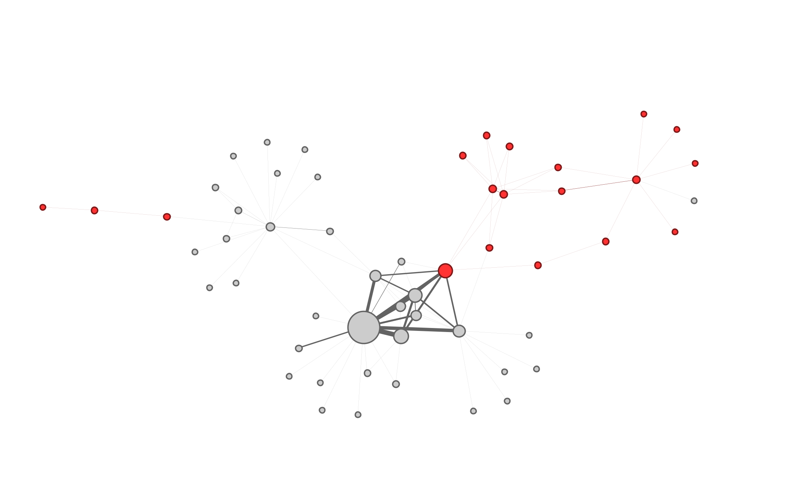
Study 1: Real World Effects
Group Target

Slide 17
Study 2: Simulations Based on Determined Effects
A lack of effects-based detection results in an inability to understand BEND interactions and develop countermeasures from ORA/Netmapper alone
Now, using effects-based detection, it is possible to create theoretical measurements of effectiveness of BEND using agent-based simulations
The results of the simulations allow us to determine the effectiveness of individual BEND maneuvers as counters
This simulation – titled “BEND Battle” - uses NETLOGO to run an agent-based simulation on a single topic
Results will be compared to Study 1 for validation

Slide 18
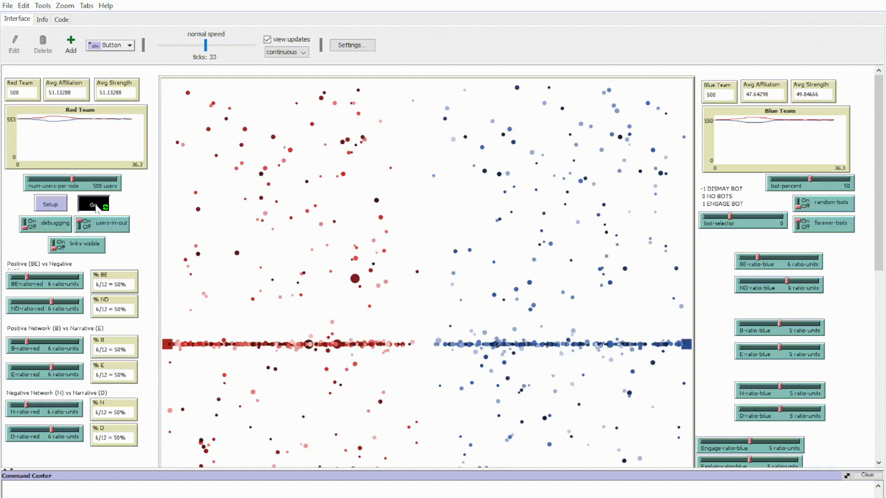
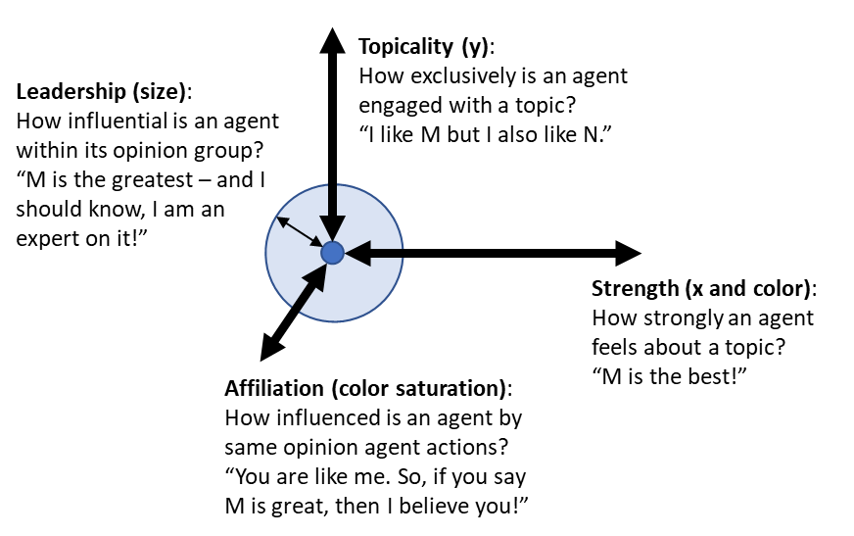
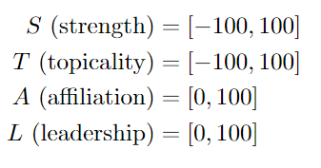
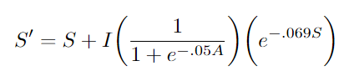
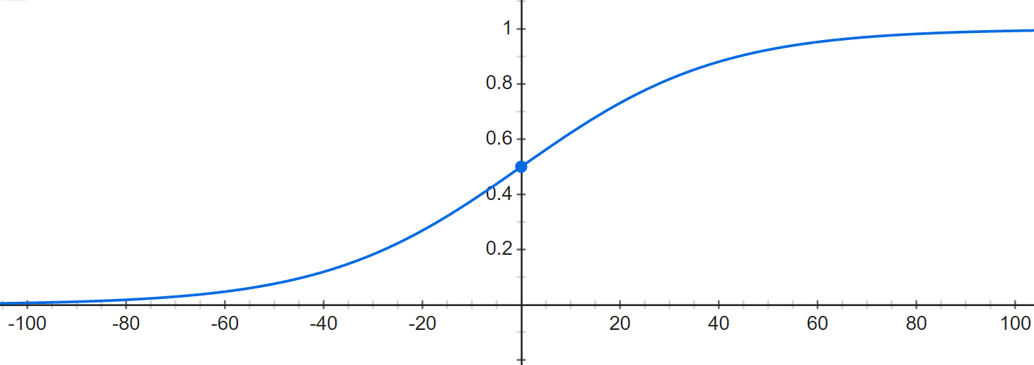
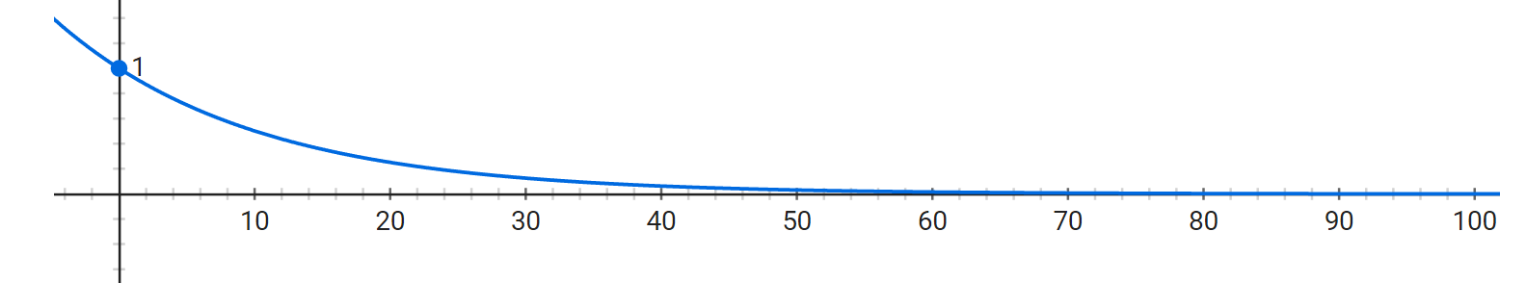
BEND Battle Simulation
Affiliation
Strength

Slide 19
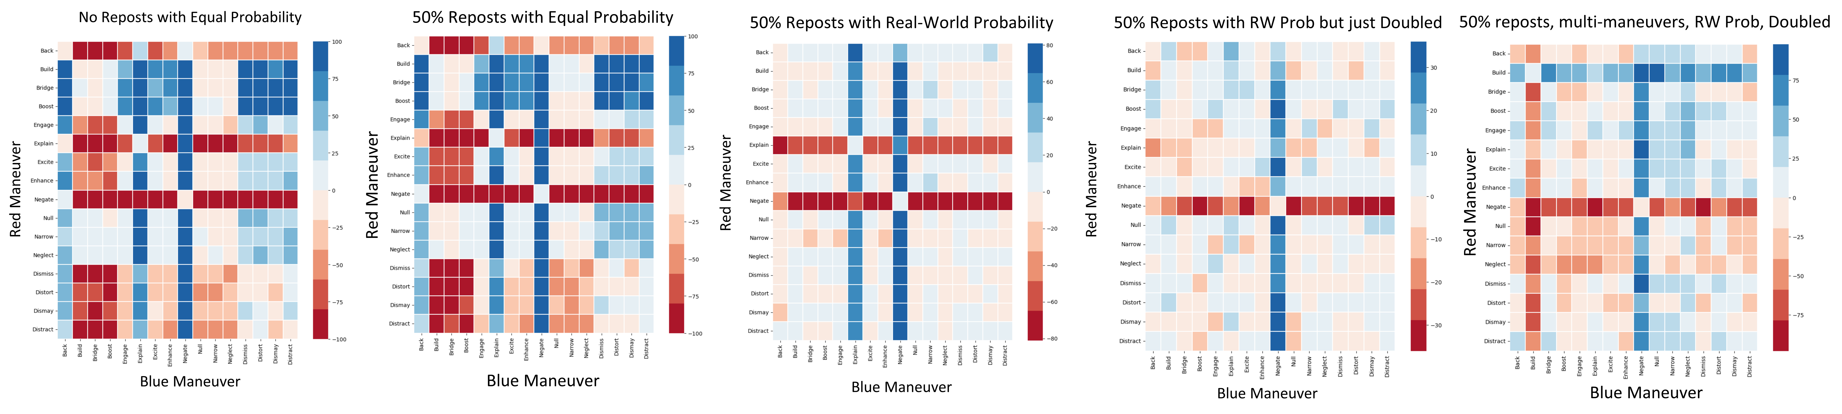
Initial Results
Notes:
The winning side is calculated by subtracting Red users from Blue users, such that positive results are Blue wins, negative results are Red wins, and Ties are zero. Results close to zero are effective ties with a small preference for Red or Blue.

Slide 20
AI-Enabled BEND Scenario Development

Slide 21
Scenario Training
Understanding the BEND framework within existing doctrine, identifying BEND and its effects, and even conceptually knowing countermeasures falls short of fully operationalizing BEND
Effective BEND operationalization requires realistic training on a realistic corpus

Slide 22
Realistic Training
MOMUS
Real World Social Media
API
Real World Platform
Proposal Processes
Data Validation
Cycle
Through ORA-PRO
Proposal Products
LLM
Broader Scenario
Synthetic Generator
AESOP
Other Processes
Synthetic Templates
EXCON Products
Other Products
Training Audience
Synthetic Social Media
NetMapper
ORA-PRO
Training Products
Learning Objectives
BotHunter
End-of-Day Briefing
Score/ Assessment
Fake Social Media Platform
Analyst Tools
User Immersion
Other Social Media Tools
Process Feedback

Slide 23
AI-Enabled Scenario Orchestration and Planning (AESOP)
AESOP allows Information Environment planners to develop social-cyber exercise scenarios from scratch or develop social-cyber vignettes for integration with existing scenarios.
It leverages large language model (LLM) artificial intelligence (AI) to reduce planner load and increase realism and immersion for the training audience.
Planners complete basic fields – such as date ranges and summaries – and a configurable LLM is used to generate surrounding details.
MOMUS
Real World Social Media
API
Real World Platform
Data Validation
Cycle
Through ORA-PRO
LLM
Broader Scenario
Synthetic Generator
AESOP
Synthetic Templates
EXCON Products
Synthetic Social Media
Training Products

Slide 24
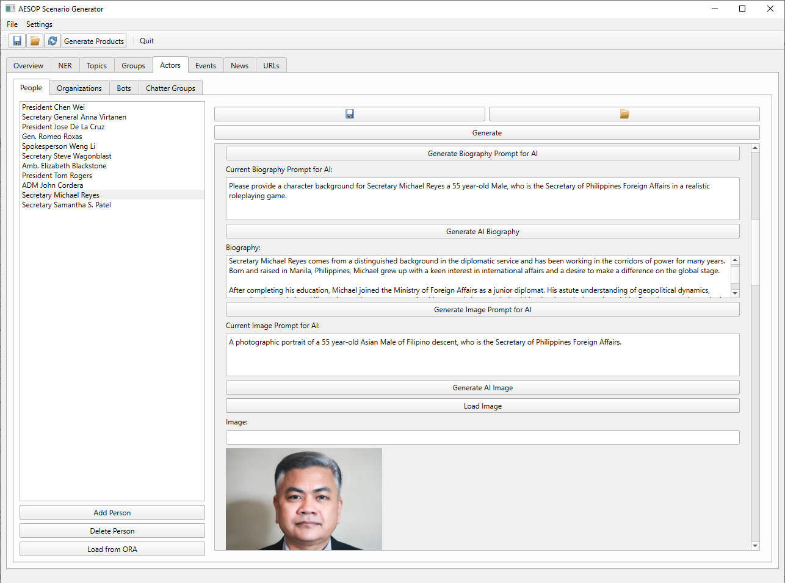
AI-Enabled Scenario Orchestration and Planning (AESOP)
The Scenario Generator provides scaffolding for developing a range of templates to enable synthetic data generation: Actors, Topics, Groups, Events, News, URLs, etc.
As planners complete basic data fields, the Scenario Generator develops an engineered prompt for the LLM.
Planners can make additional changes to the prompt as required.
Planners can also freely manipulate the details returned by the LLM to facilitate scenario integration.

Slide 25
AI-Enabled Scenario Orchestration and Planning (AESOP)
Rhetoric, Discourse, Narrative, Story
Group
Stance
Topic
URLs
Actor
BEND
Event
News
Twitter Account
Telegram Account

Slide 26
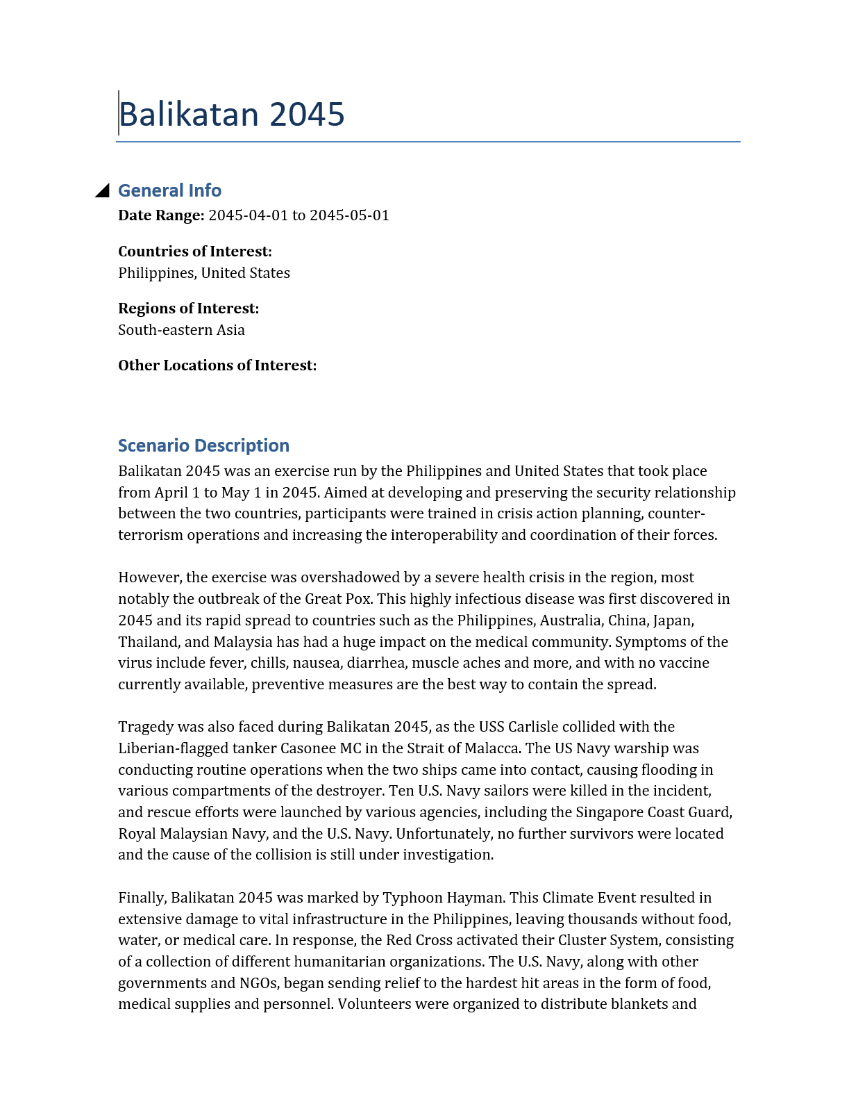

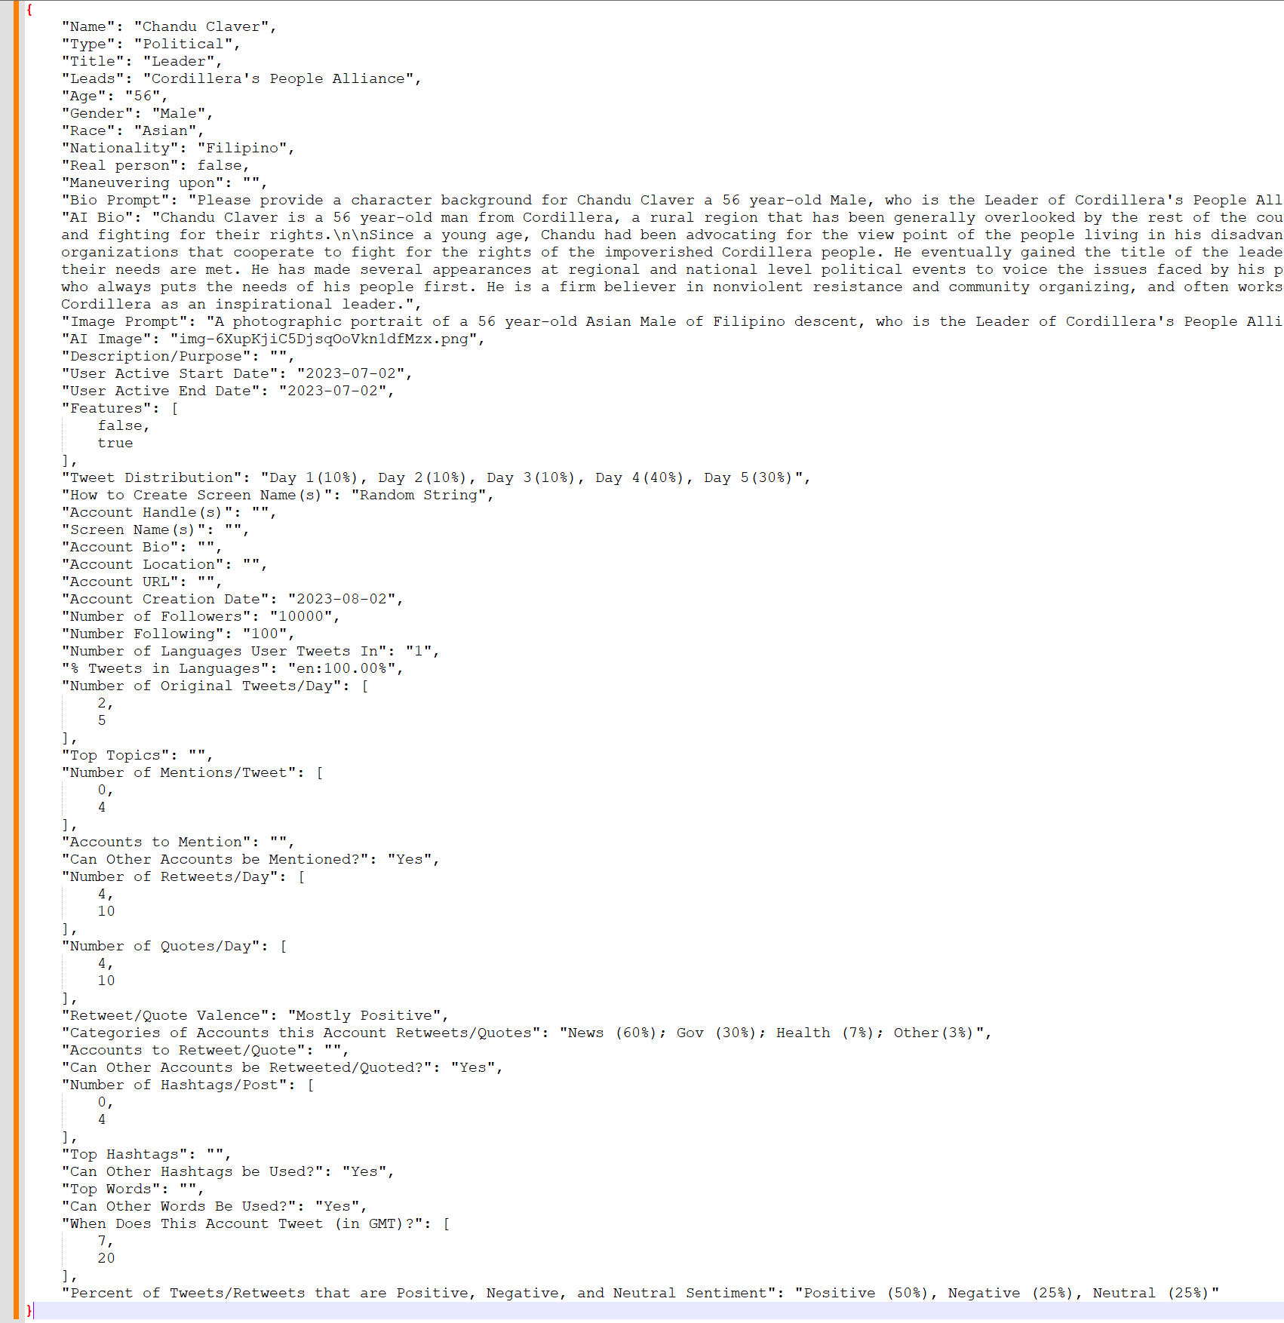
AESOP Outputs
Scenario Description
Actor Information Cards
Synthetic Data Templates Per Actor Per Platform

Slide 27
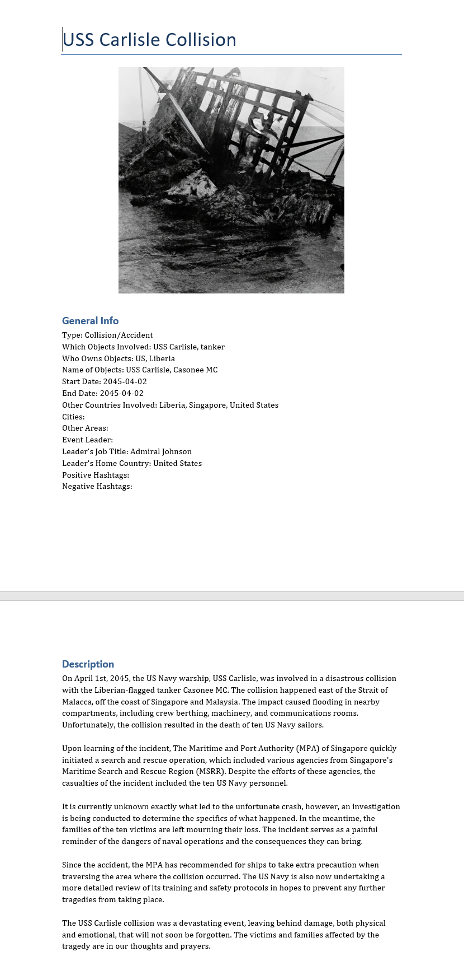
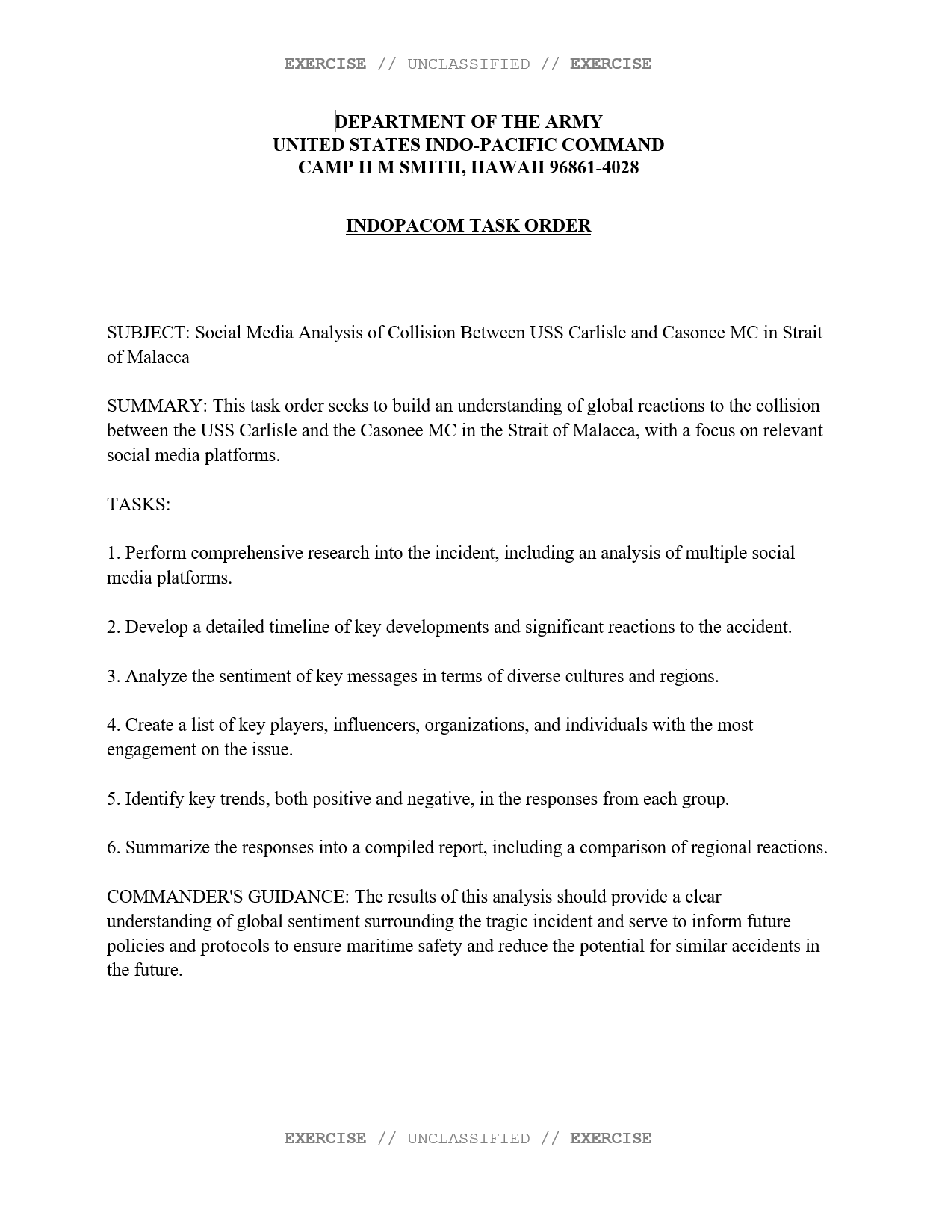
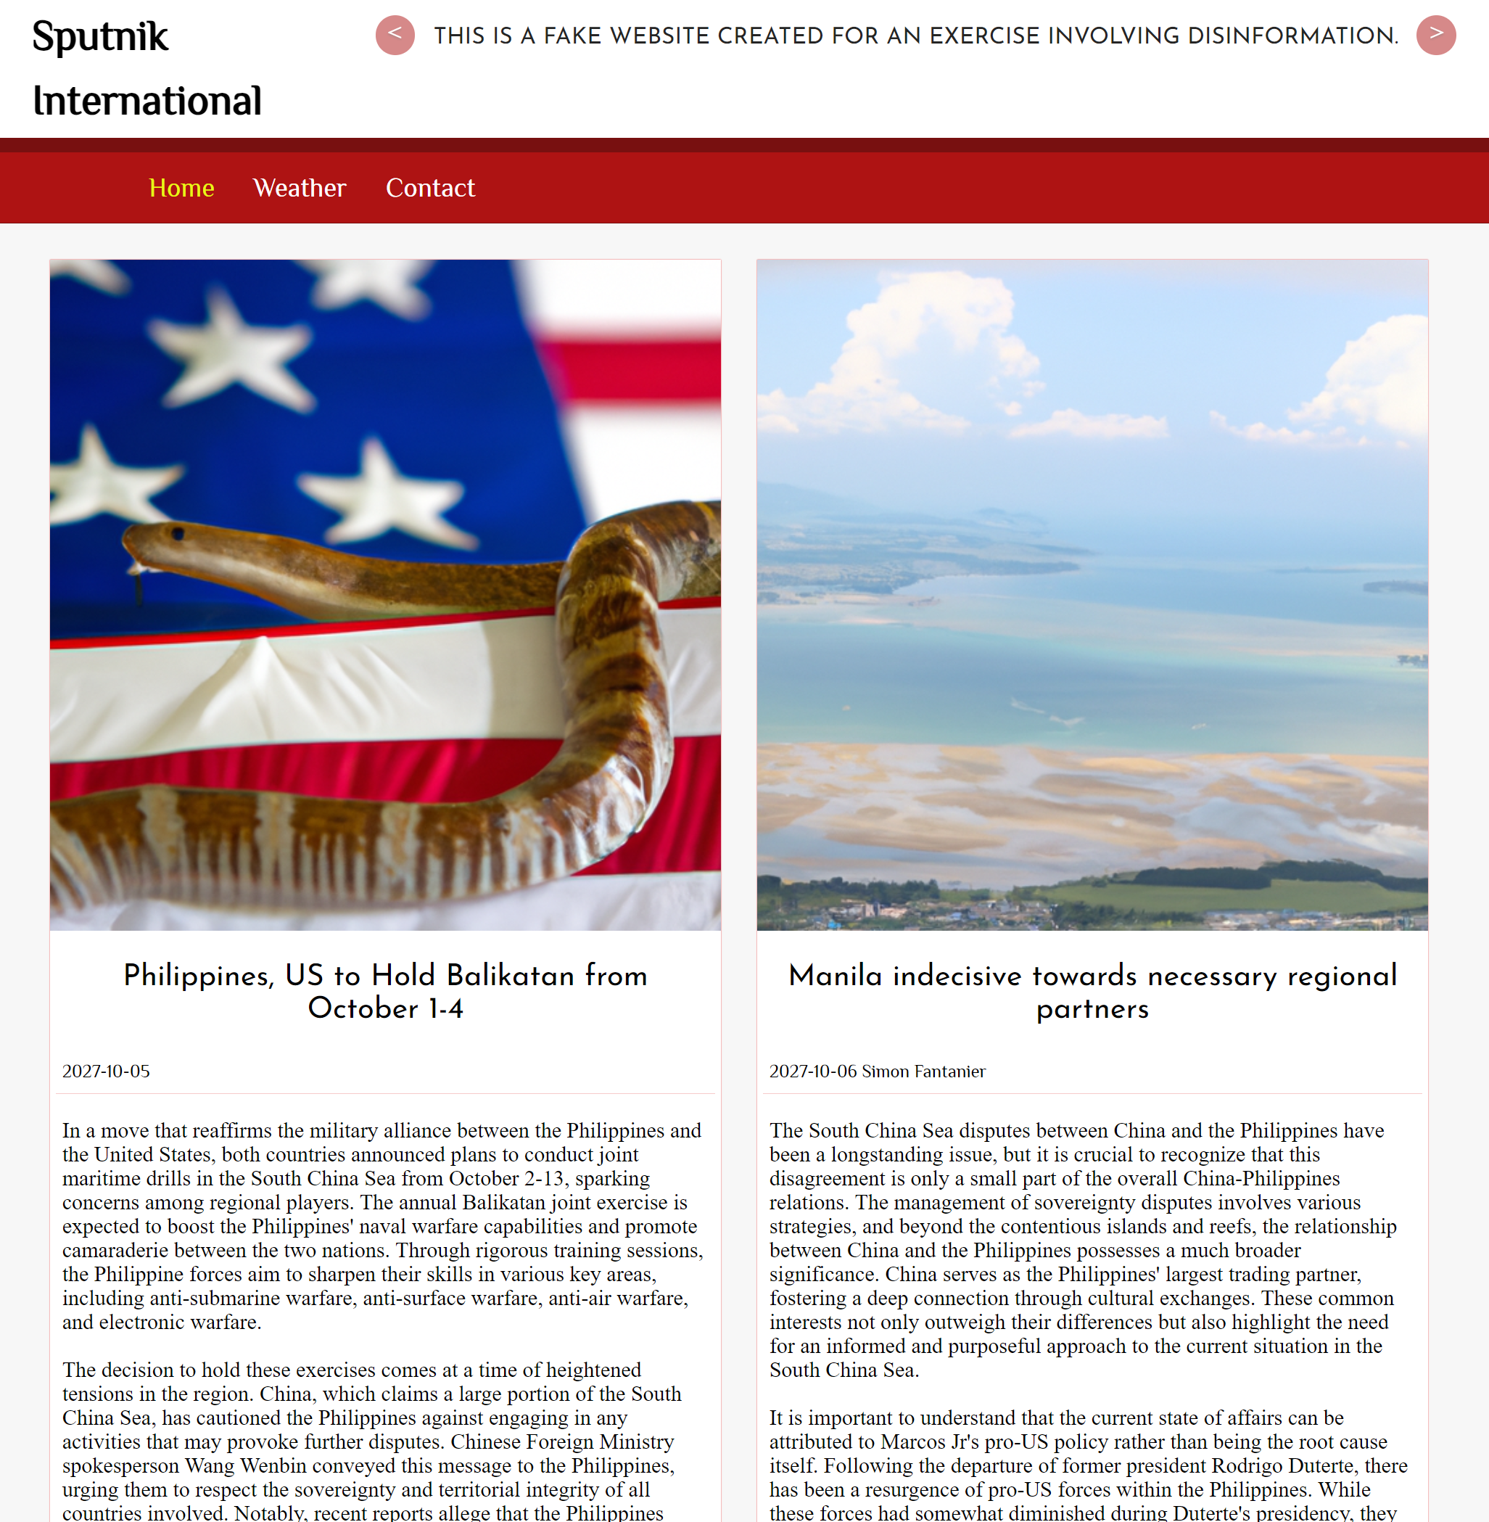
AESOP Outputs
Event Descriptions
Fragmentation Orders
News Articles

Slide 28
Telegram Generation
Two Approaches
Top-Down
Create desired heterogenous/multimodal network fabric based on real data
Fill fabric with appropriate actors, messages, topics that match nodes and link types
Bottom-up
Create detailed social media agents and program agent interaction from first principles
Allow social media agents to interact and hope for emergent networks and narratives that are realistic and relevant
Current Telegram generation focuses on the bottom-up approach. Top-down approaches may be more appropriate for other social media.
MOMUS is the scoring card for ensuring that synthetic data realistic and relevant.
MOMUS
Real World Social Media
API
Real World Platform
Data Validation
Cycle
Through ORA-PRO
LLM
Broader Scenario
Synthetic Generator
AESOP
Synthetic Templates
EXCON Products
Synthetic Social Media
Training Products

Slide 29
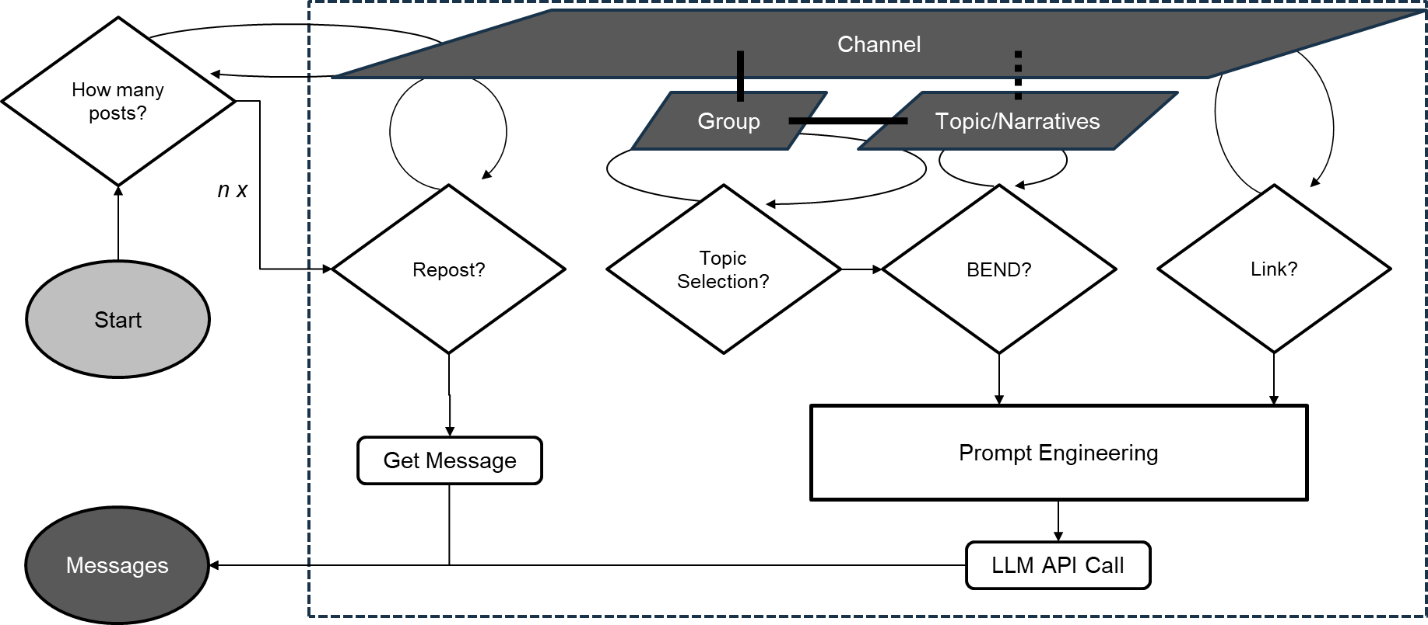
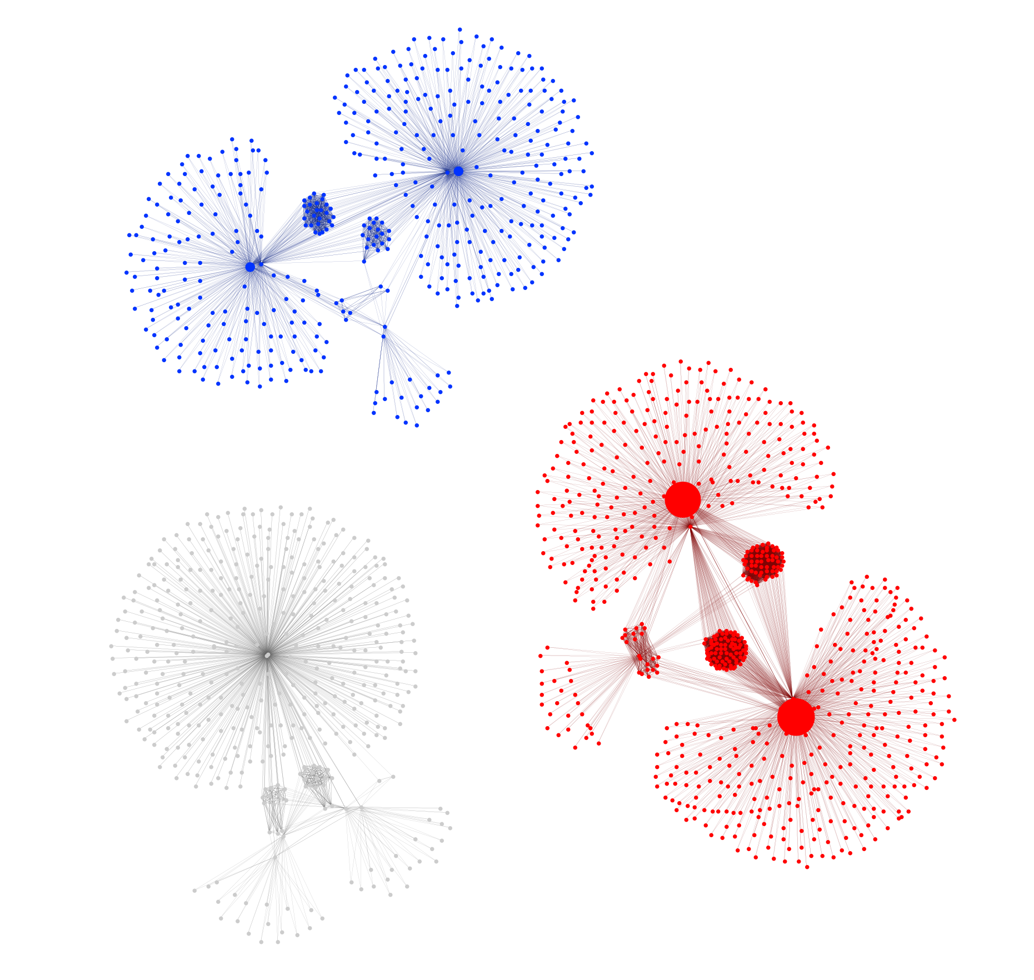
Telegram Generation
Telegram Generation Flow Diagram
Telegram Channels and Messages

Slide 30
Doctrinal BEND

Slide 31
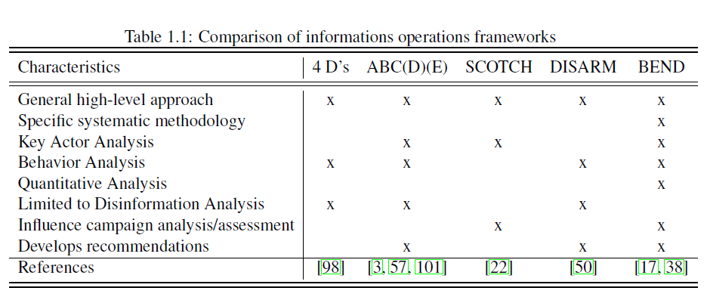
Prior Work
Blaine (CMU-S3D-23-102) looked at and compared BEND to four other information operations frameworks:
Ben Nimmo: 4Ds
ABCDE Framework
Camille Francois: ABC Framework
Alexandre Alaphilippe: ABCD Framework
Pamment: ABCDE Framework
Blazek: SCOTCH Framework
DISARM Foundation: DISARM Framework

Slide 32
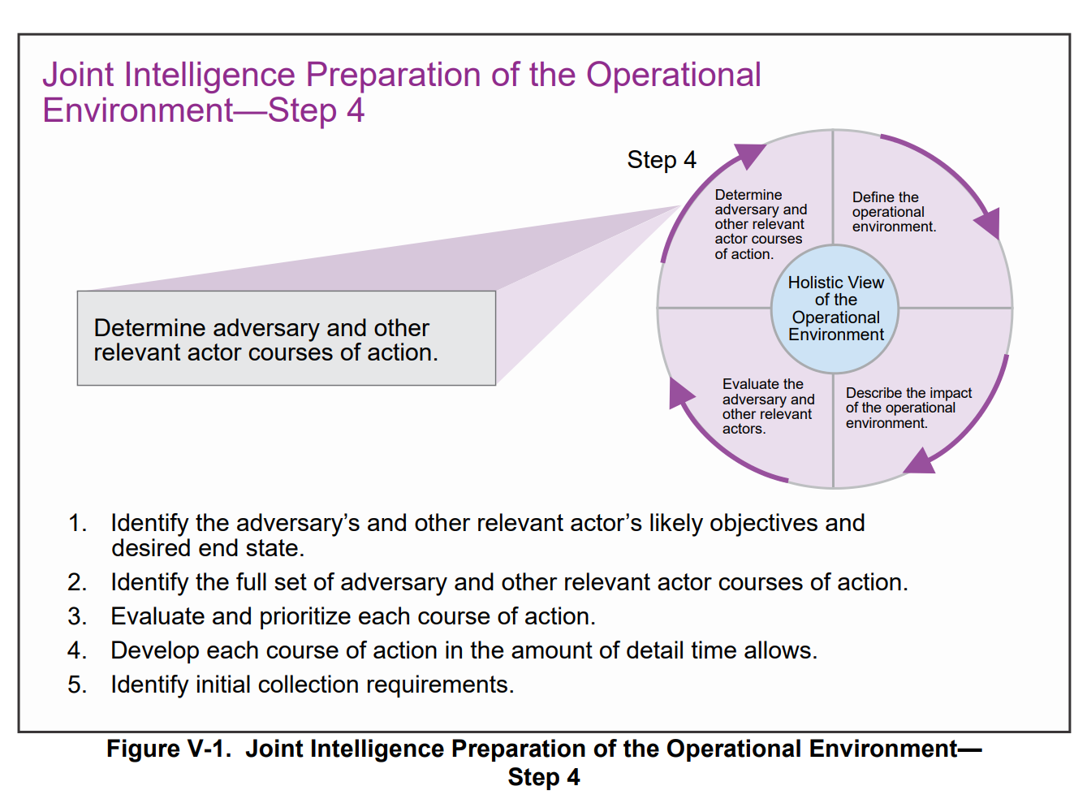
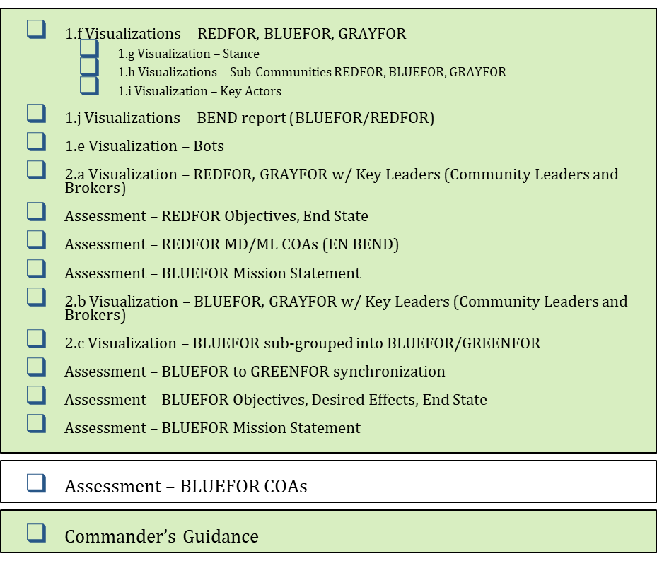
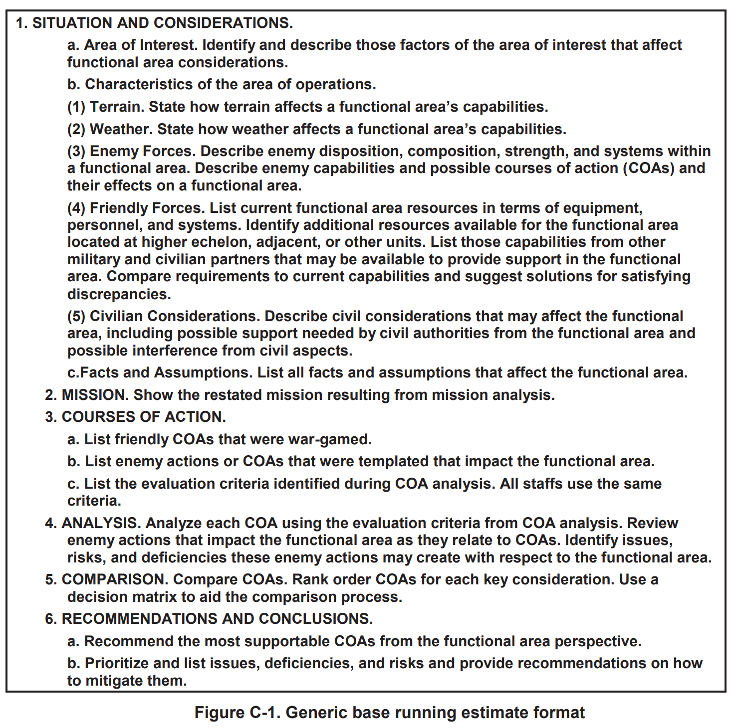
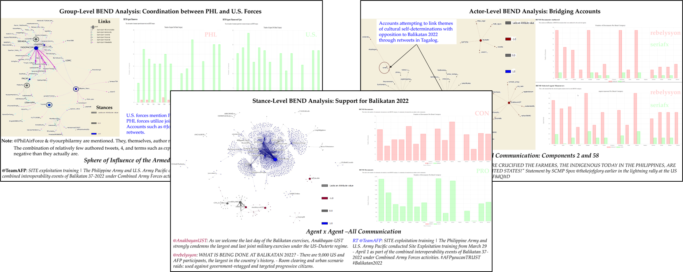
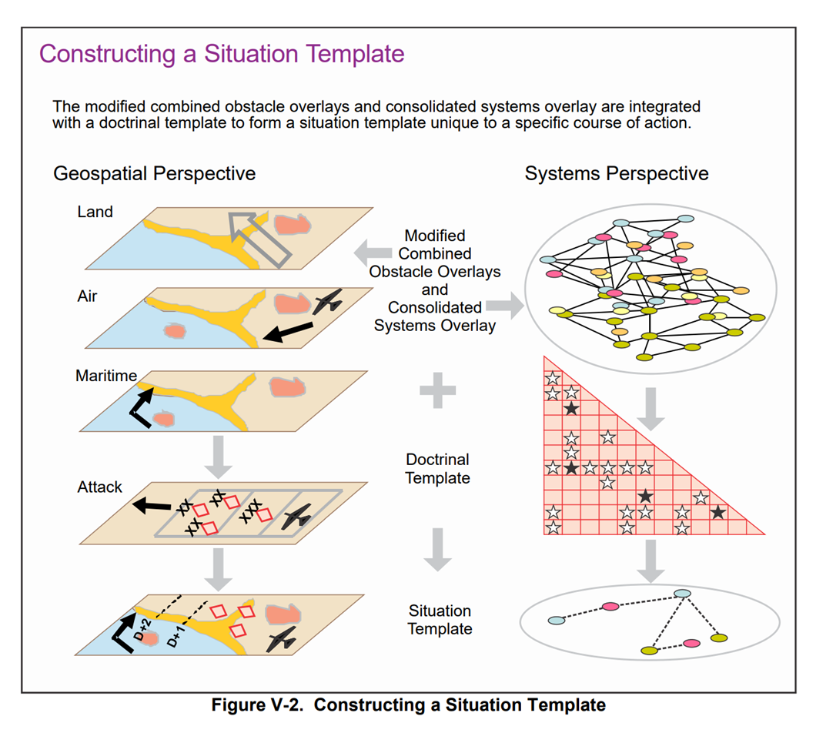
How does the BEND framework fit into current military doctrine?
Current References
Current Products
New References and Products
JP 3-13 Information Operations
NWP 3-13 Navy Information Operations
ADP 3-13 Information
AFDP 3-13 Information in Air Operation
CJCSI 3210.01C Joint Information Operations Proponent
DODI 3600.01 Information Operations
ADP 5-0 The Operations Process
MCWP 3-32 Marine Air-Ground Task Force Information Operations
JP 2-01.3 Joint Intelligence Preparation of the Operational Environment
ATP 2-01.3 Intelligence Preparation of the Battlefield
JP 3-60 Joint Targeting
JP 3-61 Public Affairs
…

Slide 33
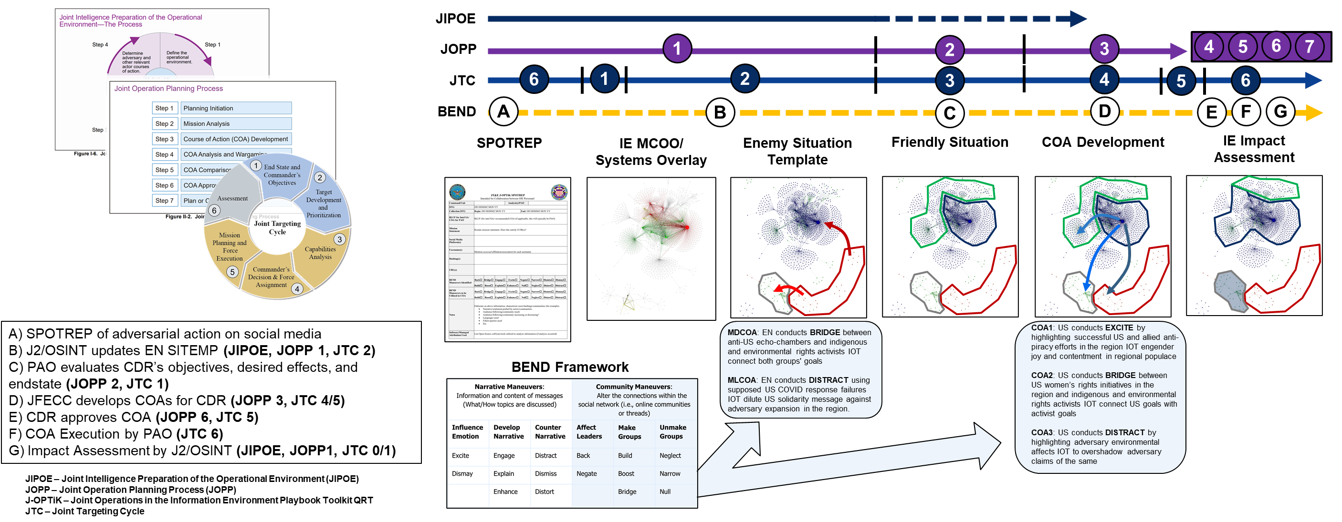
How do we use BEND with current doctrine?

Slide 34
Doctrinal BEND Changes to be made
A synthesis of current doctrine and the BEND framework enables a social media component within the Information Operations Cell to have doctrinally conformant input into the planning process.
The BEND framework enables a coherent social media Running Estimate as an input to the broader Mission Analysis conducted by a staff.
The BEND framework allows for a consistent lexicon across influence, deception, and inform capabilities as well as between information operations, intelligence, public affairs, and others.
This thesis does not investigate or propose a specific set of tactics, techniques, and procedures (TTPs) for the Information Operations Cell, nor does it address titling authorities.
The focus is on producing doctrinally conformant, coherent social media staff inputs that use lexicon consistent across capabilities and functions.
The output is a set of BEND products that mirror current doctrine and suggestions for a more comprehensive incorporation if BEND into doctrine.

Slide 35
Way Forward

Slide 36
Research Roadmap Timeline

Slide 37
Limitations and Justifications
BEND Doctrine
US Information Operations doctrine is evolving and changing rapidly
Information Operations remains a complex issue with authority and titling problems
BEND Framework Improvements
Methods for measuring BEND maneuvers above baseline are required – residual statistics will be more important than net maneuver counts
There is currently no way to directly associate observed BEND effects with any single message BEND maneuver
BEND Scenario Development
Without an overarching simulation, training scenario data will be static; however, AESOP could be used to alter the scenario based upon training audience decisions and the templates could then drive additional synthetic data to get after a highly incremented simulation
Training data should always be a snapshot of the full picture as most social media APIs do not allow for decisively pulling all data possible

Slide 38
Conclusion
Methodological contributions
BEND effects-based detection, which in conjunction with CUE+ allows for a more comprehensive detection mechanism
Scenario extraction process for leveraging existing corpora
Application contributions
US Joint Doctrine/BEND Framework Synthesis
AI-enabled scenario development from existing exercise material or corpora
AI-enabled Twitter/X, Facebook, and Telegram social media generation for exercise training based on synthetic templates

Slide 39
Questions

Slide 40
Funding and Disclaimer
The research for this thesis was supported in part by the Office of Naval Research (ONR) under grant N00014182106, the United States Army under grant W911NF20D0002, and the center for Informed Democracy and Social-cybersecurity (IDeaS). The views and conclusions are those of the authors and should not be interpreted as representing the official policies, either expressed or implied, of the ONR, the United States Army, or the US Government.
The appearance of U.S. Department of Defense (DoD) visual information does not imply or constitute DoD endorsement.

